Slide 1



Using Virtual Reality to Enforce
Principles of Cybersecurity
Jinsil Hwaryoung Seo, PhD
Dhruva Chakravorty, PhD

Slide 2
CiSE-ProS:
Training program that builds core competencies in secure-computing using hands-on activities.
NSF #1730695
Notes:
The VR program is part of CiSE-ProS.

Slide 3
Texas A&M Cybersecurity Ecosystem
Dept. of Homeland Security Cybersecurity Program
Texas A&M
High Performance
Research Computing
TAMC2
TEEX
Cybersecurity
Program
HPRC
Texas A&M
Cybersecurity Center

Slide 4
Prior Cybersecurity Programs Focusing on Physical Security
Standards for security of datacenters | National Institute of Standards and Technology
Cybersecurity Minor Program | Texas A&M University
Master of Science in Information Assurance and Security Program | Blinn College
ANSI-accredited security practitioner certification programs | The Computer Technology Industry Association
National Centers of Academic Excellence in Cyber Defense Education | National Security Agency and Department of Homeland Security

Slide 5
CiSE-ProS
approaches cybersecurity training and education by:
Identifying
the needs of the community through a community workshop
Engaging
the Texas A&M and local community in CiSE-ProS outreach efforts
Developing
a set of training exercises and assessment tools
Developing
content including theory and related training exercises for on-line delivery
Integrating
the training product to launch a cybersecurity minor program at TAMC2 with an HPC/research computing support track

Slide 6
Needs for Physical Security in Data Center
Physical access control to a datacenter is a high-priority requirement.
  The National Institute of Standards and Technology Special publication 800-53 requires that any system of moderate-to-high security implement an access control scheme that “allow[s] only authorized accesses for users... which are necessary to accomplish assigned tasks.”
  Limiting physical access to datacenter devices reduces the number of possible attack vectors on those machines.
Software cybersecurity is built on a foundation of good physical access control.
Notes:
The concept of a datacenter is increasingly familiar, so training on the needs of a datacenter benefits all professions that may use these advanced computing resources.

Slide 7
CISE-PROS VR
We have developed a system that utilizes the emerging technology of virtual reality to enhance cybersecurity education at the university level, particularly in the area of physical security.

Slide 8

Adopting Emerging Technologies
Participants can explore the consequences of their actions.
Participants can do a self-paced training using modular training materials.
Participants can collaborate with simulated characters to learn complex tasks.
Participants can learn from direct manipulation of individual components.
Virtual Reality
Provides a safe and immersive training environment
Notes:
Direct manipulations in the program allow learners to
interact with individual components of compute infrastructure to determine their viewing orientation and
to control the pace of the content manipulation

Slide 9
Objectives
Use research-based methods to develop a high-impact, high-immersion opportunity that introduces participants to concepts in computing including software, hardware, networking, cybersecurity and data management practices
Reinforce and develop further knowledge of cyber skill sets through exercises.
Retain participant interest after the camp by offering access to series of free in-person and online cybertraining themed short courses and seminars at Texas A&M.

Slide 10
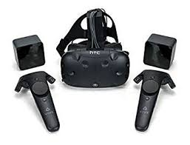
Hardware
HTC VIVE

Slide 11
User Training Scenario in a Data Center
Entering/
Exiting
Inspecting
Replacing

Slide 12
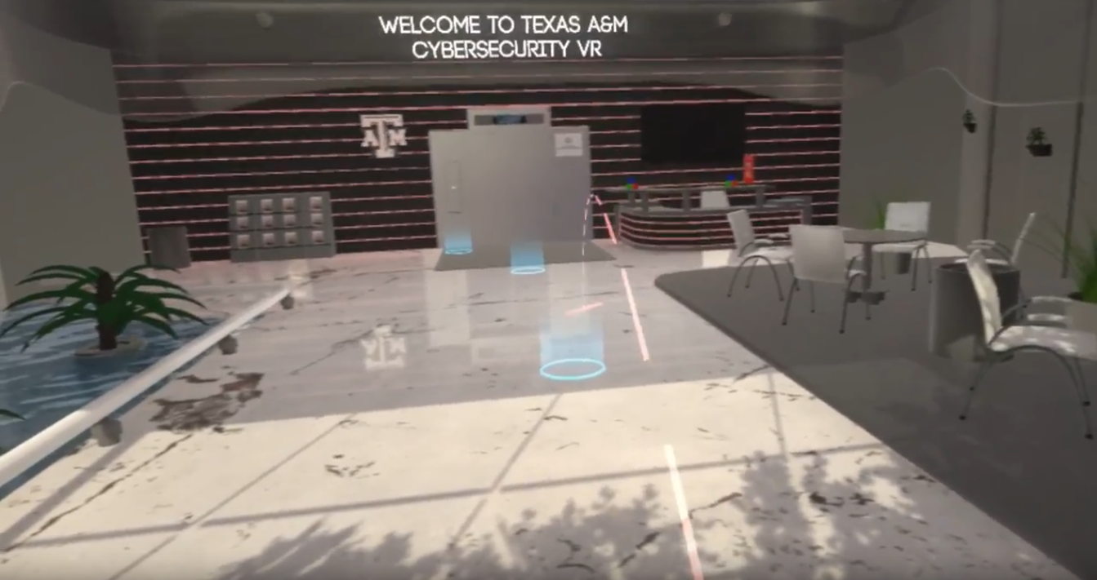
Entering/
Exiting
https://youtu.be/SkcCGkdEuNc

Slide 13
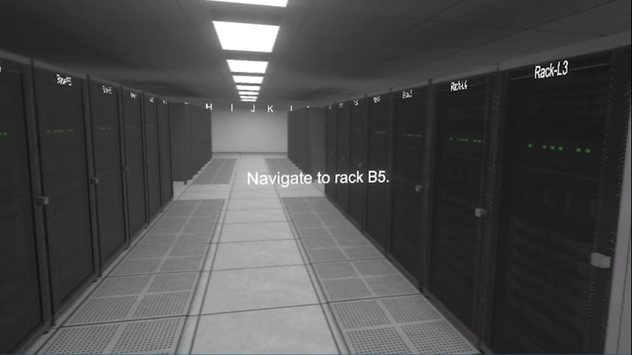
Inspecting

Slide 14
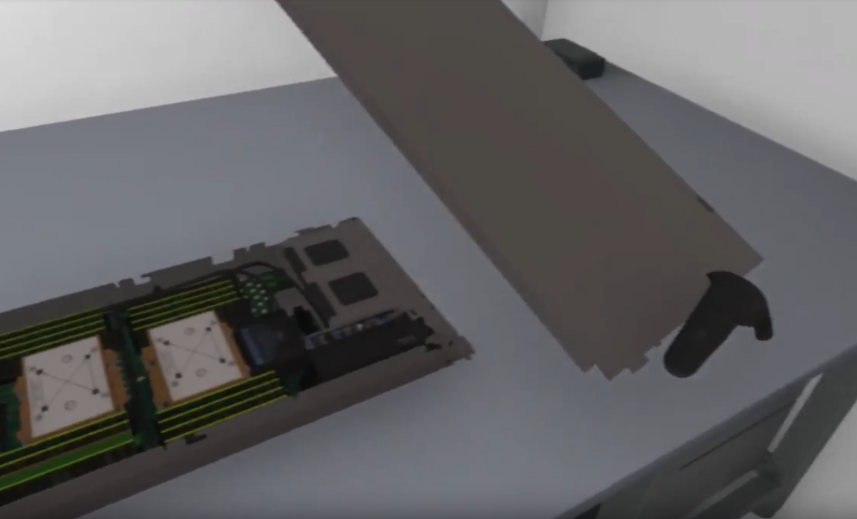
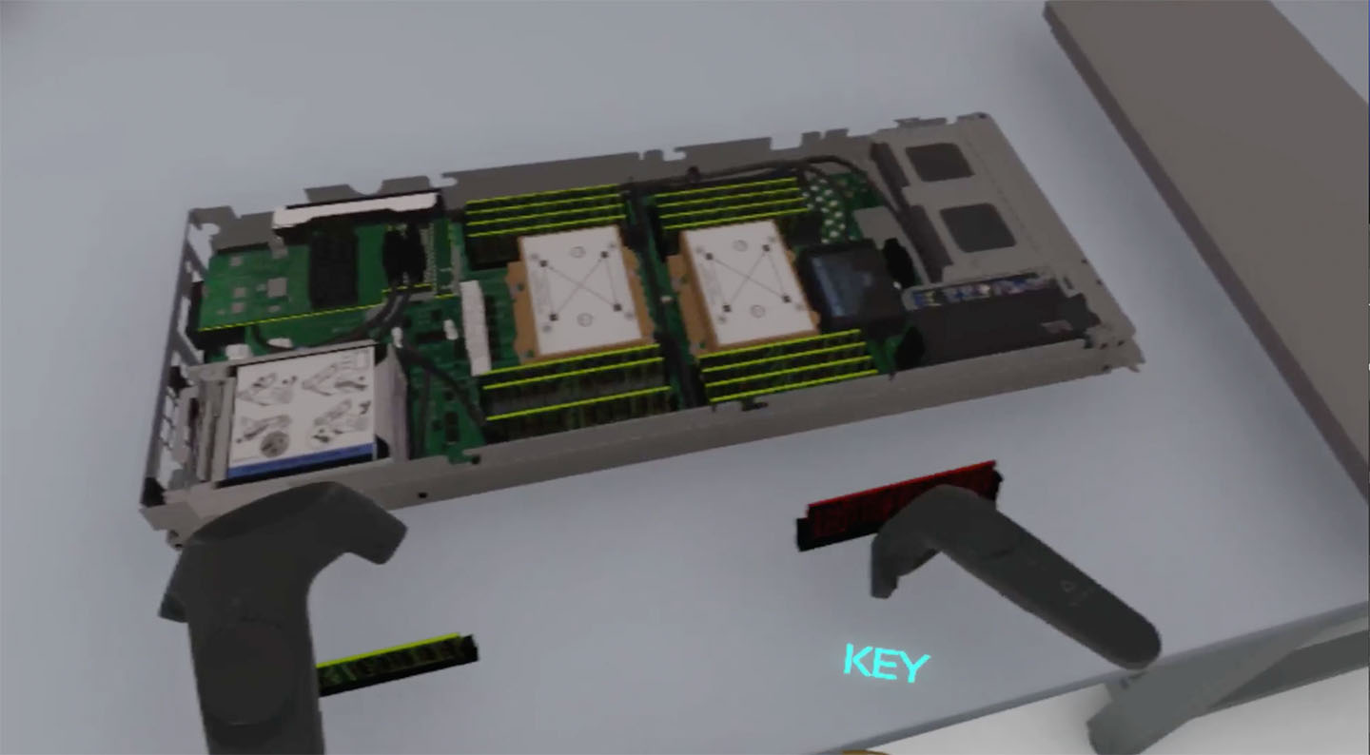
Replacing
https://youtu.be/c-MrasldK_w

Slide 15
Evaluation and Assessments
Participants:
25 Summer Computing
Academy at Texas A&M University
Individual Experience Sessions
Questionnaires
(Pre, Post, 1 week after)
Information Recall
  Data center physical security
  Procedure of fixing a node with a broken RAM in the VR application
  90 % remembered after the session
  80 % remembered after one week
Other Feedback
  “VR is very interactive so it would be a good way to teach students that will keep them engaged,” (ID03)
  “It is very easy and fun to use and make, its very easy to remember information.” (ID05)
  “You can explore places rather than read them in the textbook.” (ID18)
  “Great for visual learners” (ID22)

Slide 16
Conclusions and Future Plan
Embodied interaction in a VR training program can benefit students with short term and long term memories in engaging and playful ways.
The user interface will be improved.
More experience scenarios will be explored.

Slide 17
Acknowledgements
Questions?
Contacts
Jinsil Hwaryoung Seo
hwaryoung@tamu.edu
Dhruva Chakravorty
chakravorty@tamu.edu
Texas A&M HPRC
Department of Visualization
Laboratory for Molecular Simulation
Division of Research and Provost IT
National Science Foundation (#1730695)
Dell and NVIDIA

